Slide 1
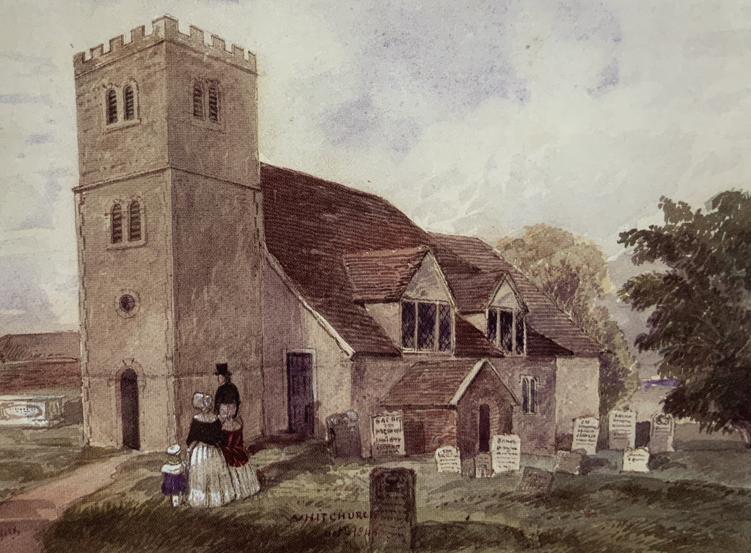
Thomas Mattingly (1750–1832)
Sarah Alford 1751 - 1817
Thomas Mattingly
(Moved to Whitchurch)
1750 - 1832
William
Mattingly (Whitchurch)
1778 - 1806
Robert
Mattingly (Whitchurch)
in 1782
Mary Mildenhall 1783-1853
Richard Mattingly
(Whitchurch)
1783 - 1830
Mary
Mattingly
(Whitchurch)
in 1785
Dinah
Mattingly
(Whitchurch)
in 1788
Sarah Mattingly
(Whitchurch)
in 1790
Christopher Rampton
Monk Sherborne
1790 - 1865
Francis Alford Mattingly (Whitchurch)
in 1794
All Hallows Church. Whitchurch.
All Hallows Church records for Mattingly.
Notes:
Thomas is born in 1750 to Richard and Ann Mattingly in Wootton St. Thomas, where the family have lived for many years. He is the second son of their four children. He moves to the larger Market town of Whitchurch, which is 10 miles away by 1778, whilst the rest of his family remain in the village. Here he marries Sarah Alford before 1778, as this is the year his first child William is born. He goes on to father at least six more children. There are a number of records for the family in the Parish Register for All Hallows Church where they would have worshipped. When Thomas died in 1832 at Whitchurch, he was shown as having lived for 86 years, a good age for those times.

Slide 2
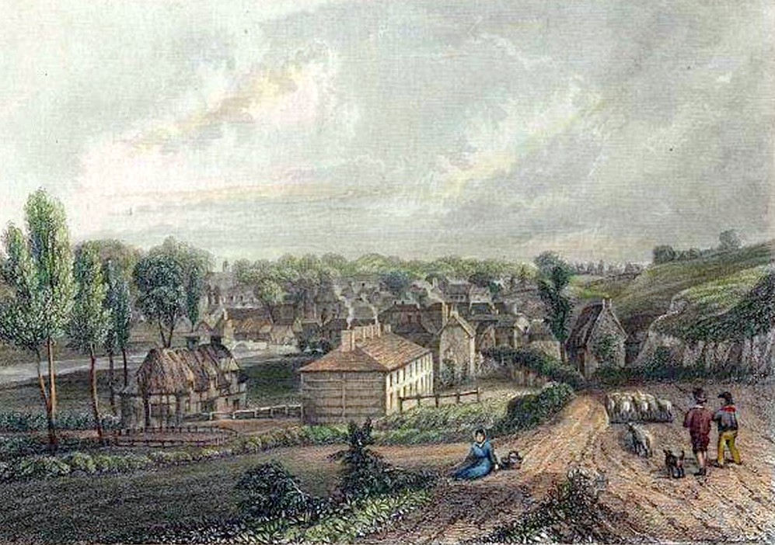
Thomas Mattingly (1750–1832)
Whitchurch.
Hurstbourne House, Whitchurch.
Notes:
The map shown here of Whitchurch shows the large Hurstbourne Park estate owned by the Duke of Portsmouth, which may have been where the Mattingly family were employed.

Slide 3
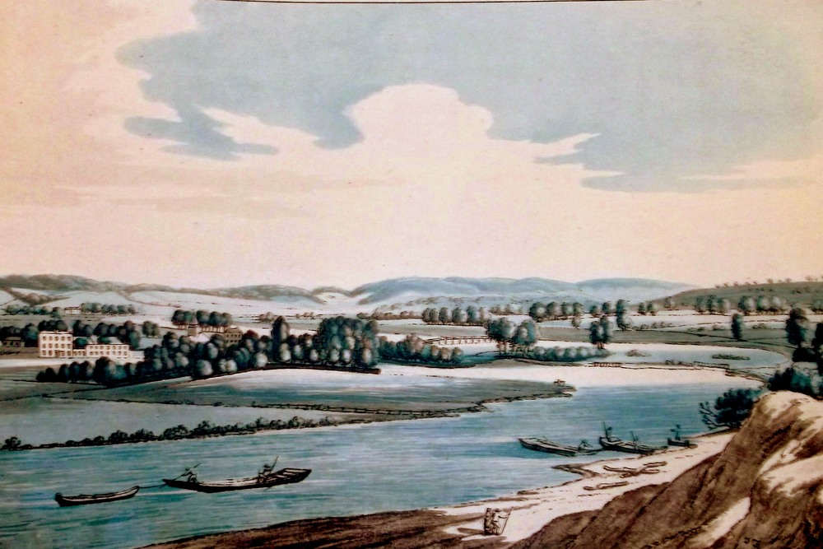
Thomas Mattingly (1750–1832)
Hurstbourne House, Whitchurch – Seat of the Earl of Portsmouth .
Hurstbourne Park can be seen on the left ot this engraving of Whitchurch dated 1793
Notes:
Hurstbourne Park is a country house and 1200-acre estate. The house was surrounded by a landscape park and pleasure ground and an ancient deer park. John Wallop, the 2nd Earl of Portsmouth inherited it in 1762 and commissioned a new house, designed by James Wyatt, which was later demolished and rebuilt in 1891.

Slide 4
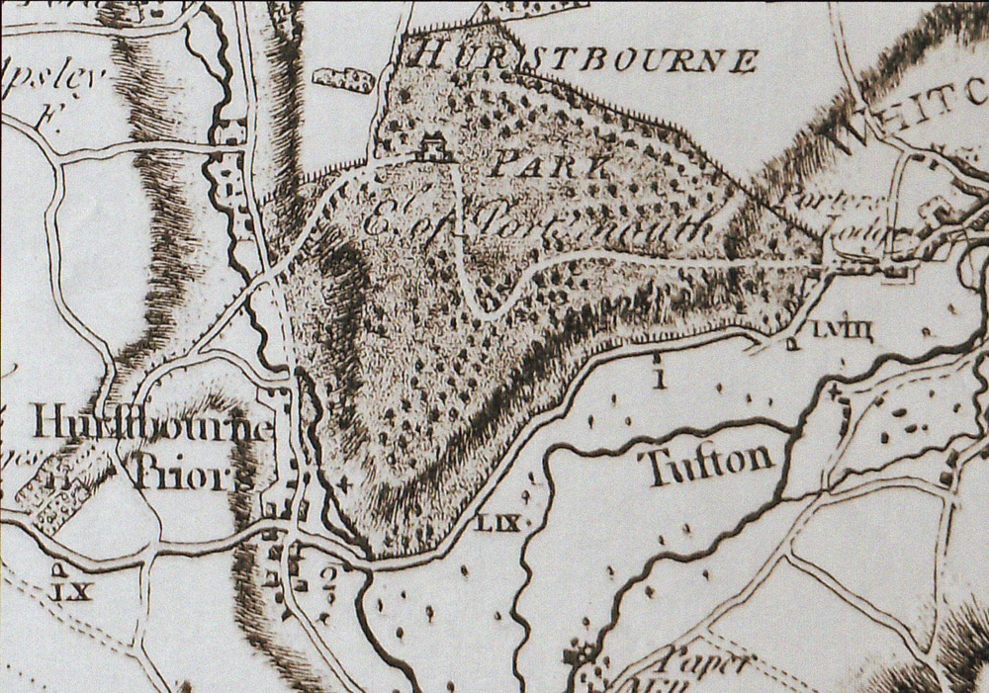
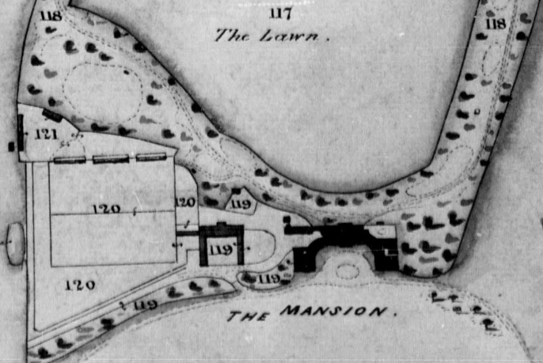
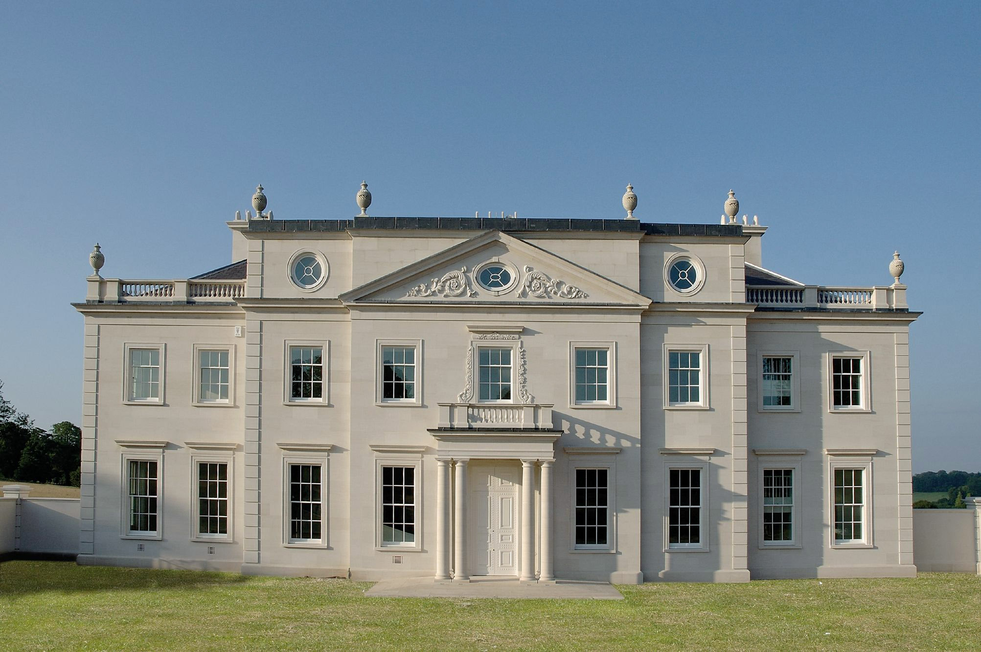
Thomas Mattingly (1750–1832)
Hurstbourne House, Whitchurch – Seat of the Earl of Portsmouth .
Hurstbourne Park - west of Whitchurch.
The Gardens of Hurstbourne Park
Hurstbourne Park House in 1911.
Hurstbourne Park House today.
Notes:
Thomas Mattingly`s son was a Gardener and this may well have been his occupation as well in the extensive Gardens of the House revealed on these plans. The photos at the bottom show the house that was rebuilt in 1891 and as its today

Slide 5
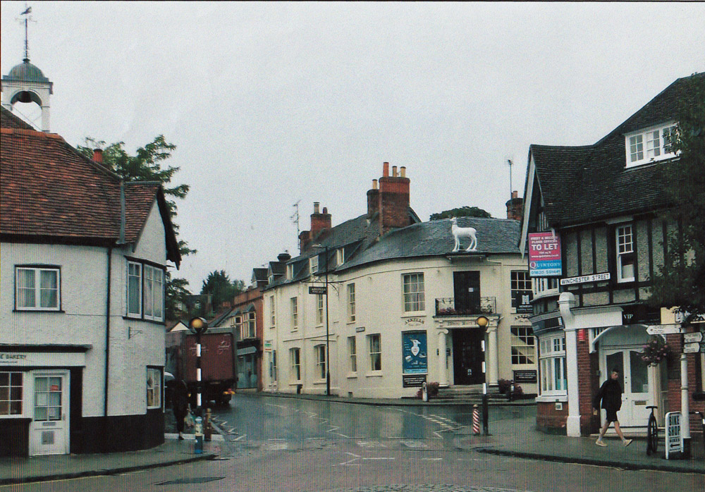
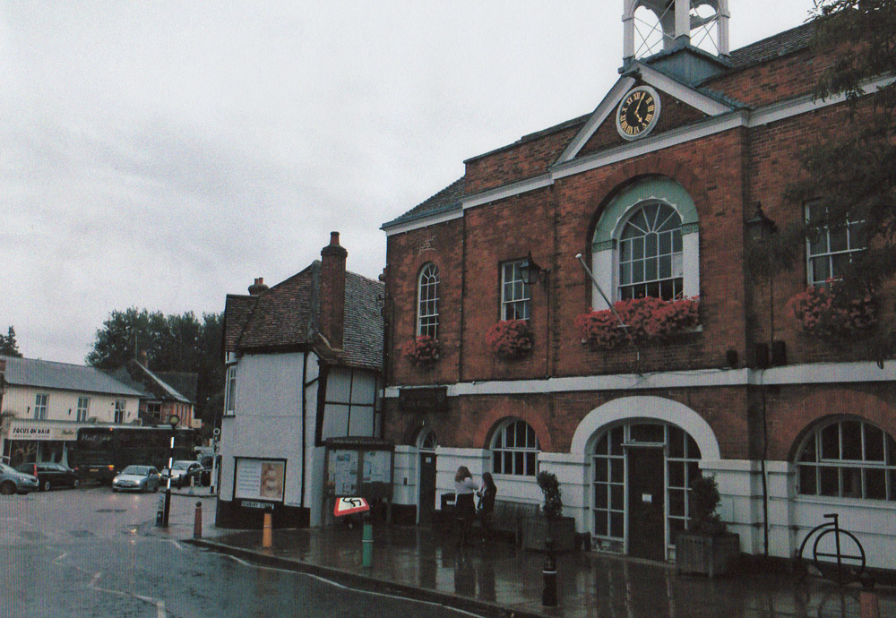
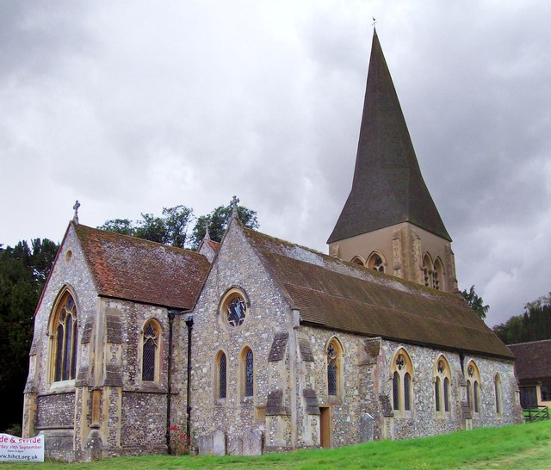
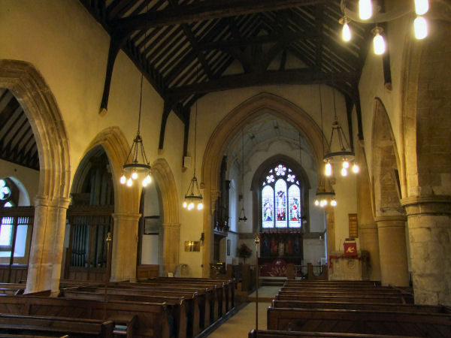
Thomas Mattingly (1750–1832)
White Hart Inn, Whitchurch.
Town Hall, Whitchurch.
All Hallows Church.
All Hallows Church interior.
Notes:
Whitchurch contains a number of historic buildings in its centre including the Town Hall built at the end of the 18th century. Local industry included flour milling, silk manufacture and the production of woollen cloth. All Hallows Church, where the Mattingly`s would have worshipped dates back to Norman times.

Slide 6
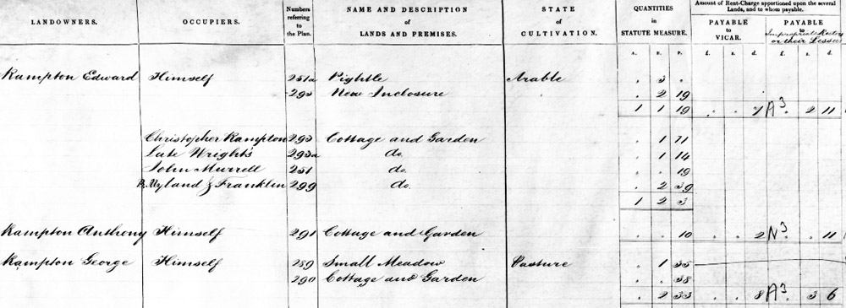
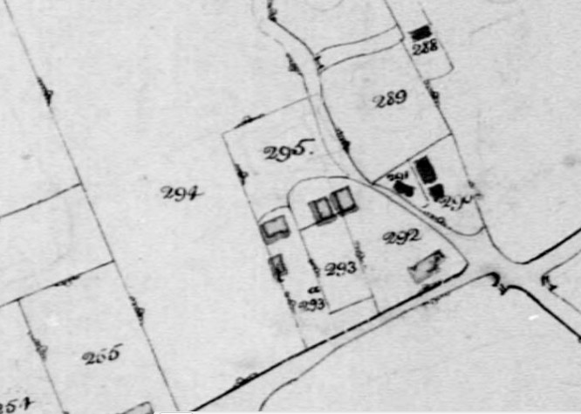
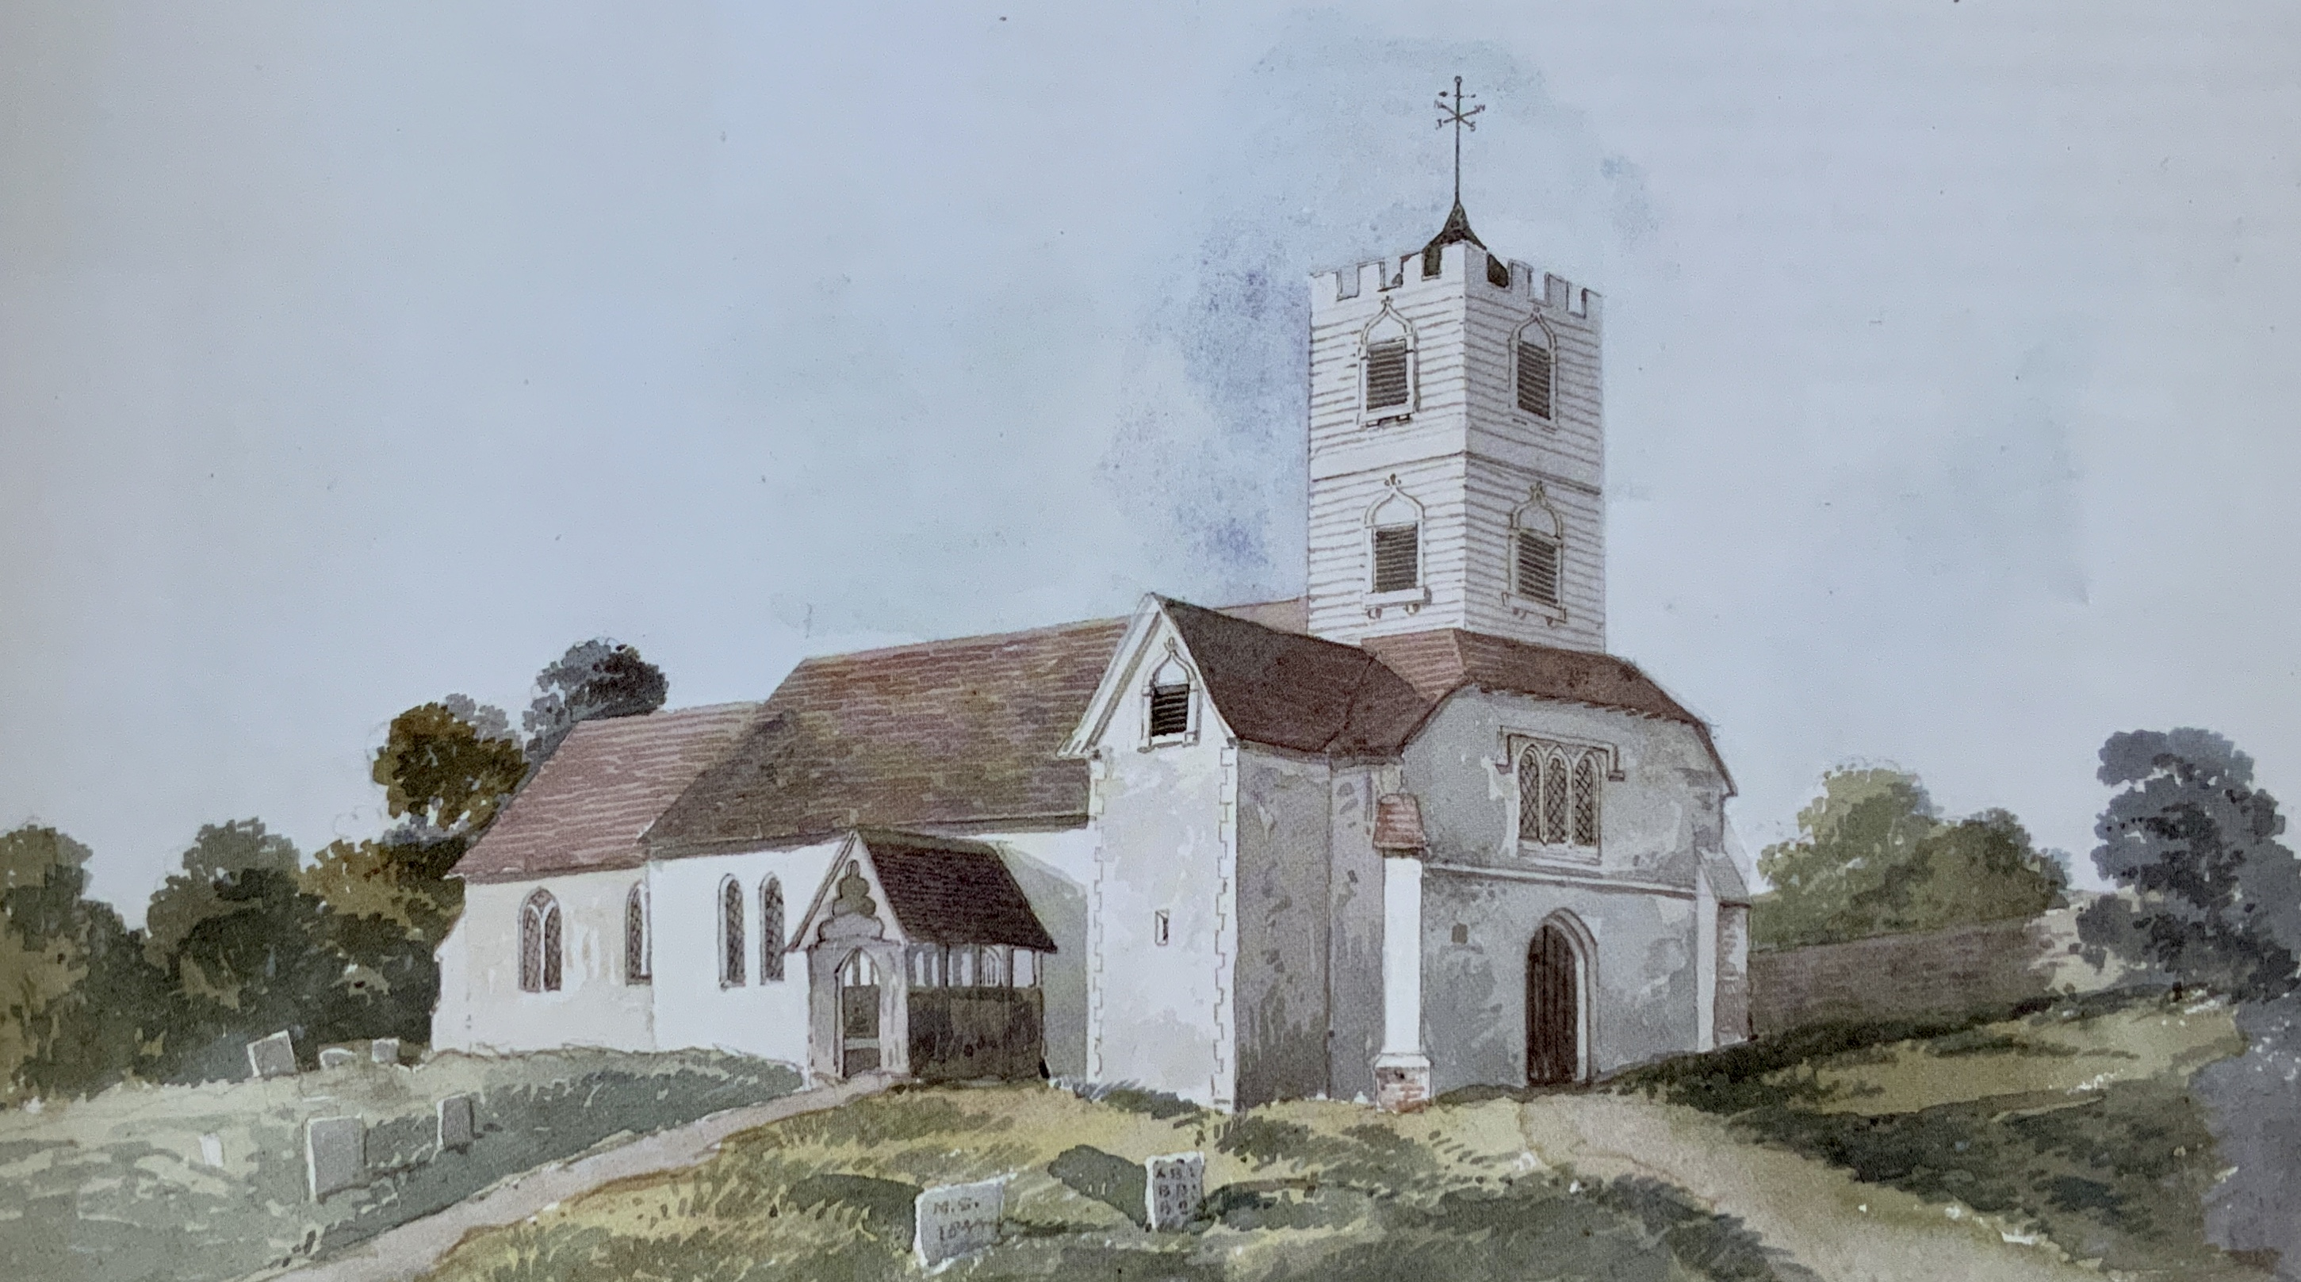
Sarah Rampton (1791–1864) – Daughter of Thomas Mattingly (1750-1832)
Thomas Mattingly
(Moved to Whitchurch)
1750 -1832
Sarah Alford?
1751-1817
Christopher Rampton
Dinah
William Mattingly
(Whitchurch)
1778-1806
Robert Mattingly (Whitchurch)
Born 1782
Richard Mattingly
(Whitchurch)
1783 -1830
Mary Mildenhall
Married 1808
1783-1853
Mary
Mattingly
b.1785
Dinah
Mattingly
b.1787
Frances Alford
Mattingly
b.1794
Sarah Mattingly
Married 1815
1791 - 1864
Christopher Rampton
Monk Sherborne
1790 - 1865
George Rampton
1816 – 1851
Emily Rampton
1834 - 1926
Caroline Rampton
1820 - 1847
Harriet Rampton
1824
Sarah Rampton
1824 - 1856
Mary Rampton
1834 - 1926
David Kimber
1835 - 1927
290 Christopher Rampton House
The 1843 Tithe Map and entry for Christopher and Sarah Rampton on plot 290 in Monk Sherborne
The 1851 Census record for Christopher and Sarah Rampton
All Saints Church. Monk Shernorne near Wootton St. Lawrence
Notes:
Through studying the Census and Tithe Maps I have found out the path taken by one of Thomas`s daughters, Sarah who was born in 1791 who married Christopher Rampton of Monk Sheborne in 1818. They made their home in this village a sort distance from Wootton St. Lawrence and were to have six children there. It has been possible to locate their small cottage precisely. It formed part of a group owned by other members of the Rampton family.

